Slide 1
Session In Php
By: Raja Kumar.

Slide 2
Contents
What is Session?
Why, Where Session is Used?
How Sessions Works?
Session As File.
Session Expiry

Slide 3
What Is Session?
Generally session means limited period of time.
Or
A meeting or period devoted to a particular activity.
To get understood about sessions in php we need to go back and review our concepts regarding http, html, client and server.
It was clearly observed that web is stateless.
There is no continuous connection between client and server.
For-example :
The server does not know that the current page was requested in past by the user or not.
A browser request a page from server – connection opens between both, server get the request and sends back the response – connection closed.

Slide 4
What is Session (Continued)
Session:
Is one that makes the web satefull. Simply maintaining the state.
Allows to track information of user.
An alternative way to make data accessible across the various pages of an entire website.
A session refers to a period of activity when a PHP script stores state information on a Web server

Slide 5
Why, Where Session is used (Need)?
Previously we store the information in a hidden form field. Even then, it persists only if the form is submitted.
To make data accessible across the various pages of an entire website.
Suppose a user is buying book online, there should be a mechanism to keep track of books added by user to basket.
Very common example be the login system, where there is need of state maintenance to check whether user is logged in or not- is the user valid.

Slide 6
How Session Work
Session Is a file stored on Server.
To find which file belongs to which user a cookie is created.
A special session cookie is set on their browser and then we look that cookie to find the place where a file resides on our server and then we can look in that file to find information in session.
The information is not there for them to see or to edit they can only change id which reference to file.
They can change id number is very long and complicated to help to ensure we do not end up with hijacking of other users session information.

Slide 7
How Session Works (Continued)
To use session we use to create a file and set cookie on user machine. Then we need to find the cookie and the corresponding file on the machine this be done with session_start().
The session_start() function starts a new session or continues an existing one
The session_start() function generates a unique session ID to identify the session
A session ID is a random alphanumeric string that looks something like: 7f39d7dd020773f115d753c71290e11f
The session_start() function creates a text file on the Web server that is the same name as the session ID, preceded by sess_
Copyright © 2012 Muhammad Baqar Qazi.

Slide 8
How Session Works (Continued)
<?php
session_start();
?>
This command should be called only once in each page, and it must be called before the PHP script generates any output, so the ideal position is immediately after the opening PHP tag.
If any output is generated before the call to session_start(), the command fails and the session won’t be activated for that page.

Slide 9
How Session Works (Continued)
When a session is initiated, the server stores information in session variables that can be accessed by other pages as long as the session remains active (normally until the browser is closed).
Because the identifier is unique to each visitor, the information stored in session variables cannot be seen by anyone else.

Slide 10
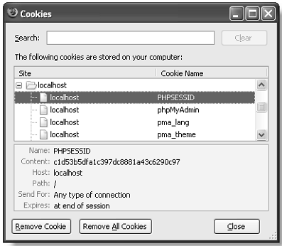
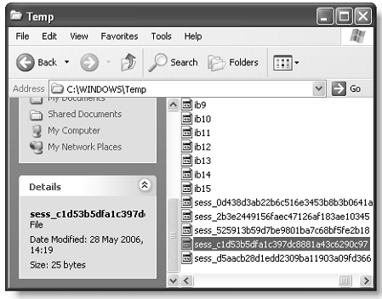
Session As File.
The cookie stored in the browser is called PHPSESSID, unique identifier.
A matching file, which contains the same unique identifier as part of its filename, is created on the web server.
PHP sessions store a unique identifier as a cookie in the browser (left) and on the server(right).

Slide 11
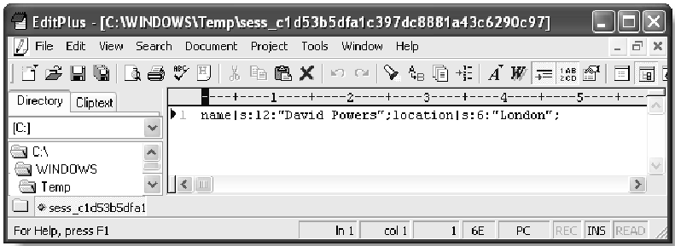
Session As File(Continued).
There is no danger of private information being exposed through someone examining the contents of a cookie on a shared computer.
The session variables and their values are stored on the web server.
Figure Shows contents of a simple session file.
As you can see, it’s in plain text, and the content isn’t difficult to decipher.
The session shown in the figure has two variables: name and location.
The variable names are followed by a vertical pipe, then the letter “s”, a colon, a number, another colon, and the variable’s value in quotes. The “s” stands for string, and the number indicates how many characters the string contains.

Slide 12
Storing & Retrieving Session Data
Php provides us the $_SESSION[] – Environment variable.
We can use $_SESSION[“varibaleName”] to store and retrieve data as we do in our normal practice.
Example:
<?php
session_start();
$_SESSION[“varibaleName”]=“THIS IS DATA TO BE STORED”;
echo $_SESSION[“varibaleName”];
?>

Slide 13
Using Session Data/Variables
Having established a session, you can now create, store and retrieve information pertaining to that session.
Information to be stored for a session is kept in session variables.
This is where you both store and retrieve session data.
These variables are all stored in a single array $_SESSION.
<?php
session_start(); // this starts the session
$_SESSION['color']='red'; // this sets variables in the session
$_SESSION['size']='small';
$_SESSION['shape']='round';
?>

Slide 14
Retrieving Session Data
The PHP session's $_SESSION variables can be used in exactly the same way as other PHP variables.
To retrieve a session variable you simply need to echo that variable.
If you need to access that variable on any other page you need to start session first.
<?php
session_start(); // this starts the session
echo $_SESSION['color']; // this is session variable.
echo $_SESSION['size'];
echo $_SESSION['shape'];
?>

Slide 15
Assignment 1:
Make six web pages, every page contain the links of all other pages, on the sixth page the result of all visited pages should be shown that how many times the user has visited each page.
Page 1
Page 2
Page 3
Page 4
Page 5
Page 6
Page 2
Page 1
Page 3
Page 4
Page 5
Page 6
Page 3
Page 1
Page 2
Page 4
Page 5
Page 6
Page 4
Page 1
Page 2
Page 3
Page 5
Page 6
Page 5
Page 1
Page 2
Page 3
Page 4
Page 6
Page 6
Page 1 Visits = 3
Page 2 Visits = 5
Page 3 Visits = 7
Page 4 Visits = 2
Page 5 Visits = 9

Slide 16
Assignment 2:
User login validation with session maintenance.
Welcome Hidaya
Enter Username & Password
MY SITE
Username:
Password:
Hidaya
Trust
Login
Click
Welcome Hidaya
Direct access
MY SITE
Please Login First.
Username:
Password:
Login

